Slide 1
Prematurity epigenome and proteome as a clue for prediction
^{of prematurity complications}
Conference Together for Innovation in Health
Cracow, 9.12.2016
Przemko Kwinta MD, PhD – Department of Pediatrics JUMC, Cracow

Slide 2
Prematurity epigenome and proteome as
a clue for prediction of prematurity complications
^{NEOMICS}
Participating centers
Jagiellonian University, Medical College
Deaprtment of Pediatrics,
Department of Medical Genetics
OMICRON Laboratories
2. University of Oslo
Department of Pediatric Research
Microarray Core Facility
3. Warsaw Medical University
Duration of the project
Start date: 1.10.2013
End date: 30.04.2017
Grant awarded
3 903 677 PLN

Slide 3
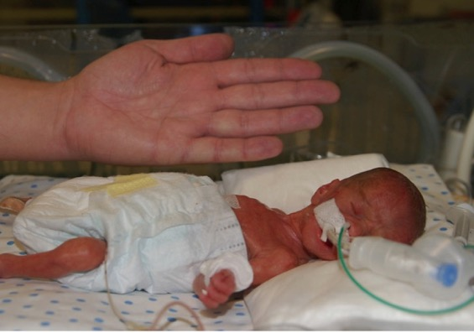
Aim - general
To shed light on the pathomechanism of short and late term complications of prematurity.

Slide 4
Objectives
To asses association of expression of whole genome with the occurrence and degree of severity of complications of prematurity in the animal model
To define in extremely preterm infants the extent of the relationship between the degree of immaturity and the epigenic and gene expression profile as well as their function defined as proteome.
To asses if in the cohort of preterm infants of the same gestational age there is a dynamic time dependent change of methylation patterns leading to parallel changes in the activity of metabolic pathways. Also to identify environmental factors which might be associated with these changes.
To define the potential impact of the epigenome of the preterm baby as well as its proteome on the risk of the development of short and long term complications of prematurity.

Slide 5
Study design
The Norwegian partner - animal experiments.
Experimental models for oxygen related diseases in premature newborn babies.
Tissue from the eyes (retina), lungs and blood for laboratory evaluation.
The Polish partners - study in neonatal units.
prospective cohort study.
147 newborns enrolled during 2.5 year time period
Nearly 300 neonatal blood samples have been collected.
Samples from the animal studies and samples from human studies were used for epigenome, gene expression (microarray methods) and proteome evaluation (iTRAQ method).
Synthesis of experimental and clinical data

Slide 6
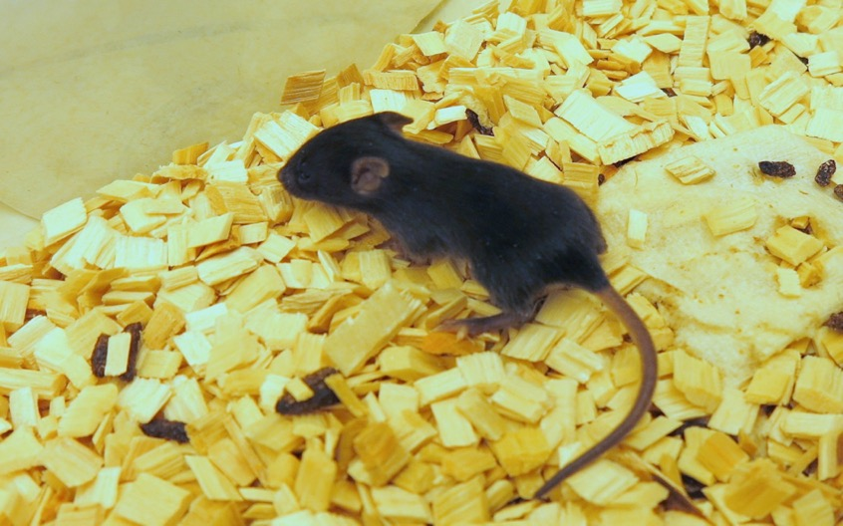
C57BL/6 Tac mouse

Slide 7
„neonates”

Slide 8
Animal experiment no 1 – chronic lung disease
„neonates”
Hyperoxia 85%
Dexamethason
NaCl
Normoxia 21%
Dexamethason
NaCl

Slide 9
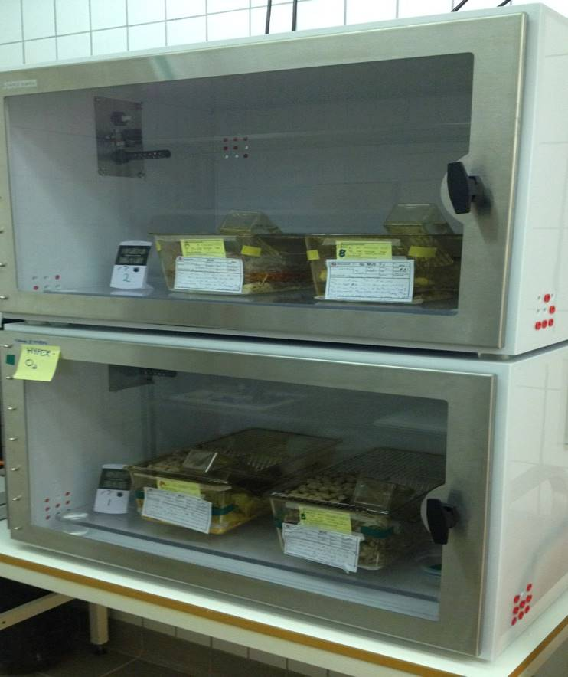
21% O2
85% O2

Slide 10
„Lungs”

Slide 11
Microscopic evaluation

Slide 12
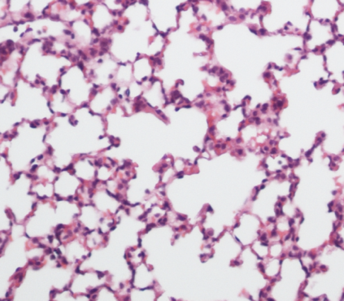
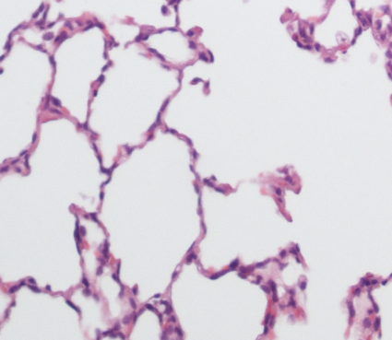
Pathomorphological Model verification
Normoxia
Hyperoxia

Slide 13
Animal experiment II - retinopathy
P7 pups – marking, randomisation
HYPEROXIA (75%O₂)
Pups + mother (5 days)
NORMOXIA (21%O₂)
Pups + mother (5 days)
P12 – 1/3 pups harvested
Room air
(5 or 16 days)
Room air
(5 or 16 days)
P17 – 1/3 pups harvested
P28 – 1/3 pups harvested

Slide 14
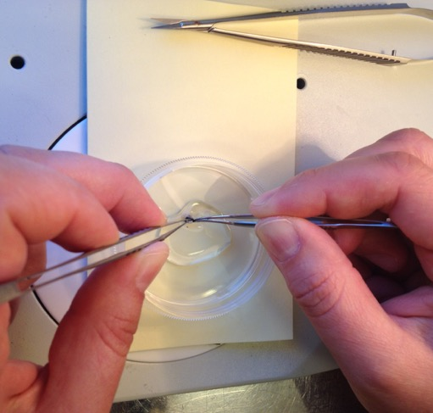
Microsurgical preparation of retina

Slide 15
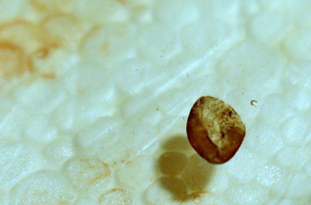
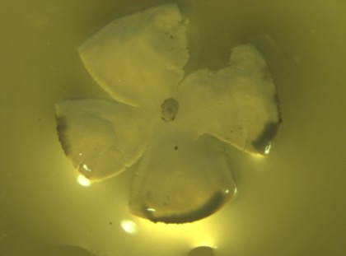
Retina for genetic studies

Slide 16
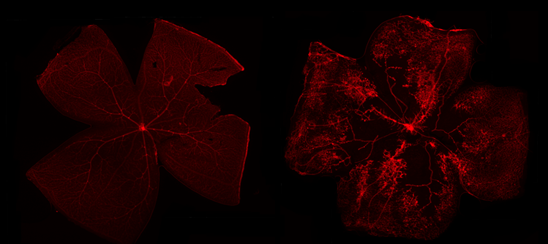
Validation of the model

Slide 17
Neonatal study
Jagiellonian University, Medical College
Deaprtment of Pediatrics,
2. Warsaw Medical University

Slide 18
Blood sampling
Newborns included into the study
<27 weeks of gestation
N=40
cord blood and ubilical cord
cord blood and ubilical cord
29-30 weeks of gestation
N=40
27-28 weeks of gestation
N =40
cord blood and ubilical cord
7 th DOL
7 th DOL
7 th DOL
36 PMA
36 PMA
36 PMA

Slide 19
Study population
2015 – project update – introducing control group of 30 healthy full term neonates

Slide 20
Human experiment
Blood:
5th DOL
36 PMA
RNA
DNA
Cell culture
Gene expression
Methylation
Proteomics

Slide 21
RNA analysis – mouse model
DATABASE | PATHWAY | REGULATION (↑/↓)
KEGG | Hypertrophic cardiomyopathy | ↑: ATP2A2, CACNA2D4, MYBPC3, MYH6, MYL3, RYR2, SGCA ↓:CACNB3, IGF1
KEGG | Dilated cardiomyopathy | ↑: ATP2A2, CACNA2D4, MYBPC3, MYH6, MYL3, RYR2, SGCA, TTN, TPM1, TNNC1, TNNI3, TNNT2 ↓: CACNB3, TGFB3,
KEGG | Cardiac muscle contraction | ↑: ATP2A2, COX6A2, COX7A1, COX8B RYR2, TPM1, TNNC1, TNNI3, TNNT2 ↓: CACNB3
KEGG | Arrythmogenic right ventricular cardiomyopath | ↑; ATP2A2, ACTN2, CACNA2D4, RYR2, SGCA ↓: CACNB3
KEGG | Viral myocarditis | ↑:MYH7B, MYH6, MYH8, SGCA ↓:CD86
KEGG | Focal adhesion | ↑ACTN2, MAPK10, PRKCB, MYLK3, ↓FIGF, COL5A2, COL6A1, FN1, LAMB3
KEGG | Calcium signaling pathway | ↑:ATP2A2, PHKG1, PRKCB, RYR2, MYLK3, SLC2A4, TNNC1 ↓:GRIN2C, PDE1A, PTGER3
KEGG | PPAR (Peroxisome proliferator-activated receptors) signaling pathway | ↑: ACSL1, CPT1B, FABP3, FABP4, ↓: SLC27A6
KEGG | Pathways in cancer | ↑SGCA ↓FLT3, GLI2, FIGF, CDKN1A
KEGG | Focal adhesion | ↑ACTN2, MAPK10, PRKCB, MYLK3, ↓FIGF, COL5A2, COL6A1, FN1, LAMB3,
KEGG | Cytokine-cytokine receptor interaction | ↑BMP7, CXCR5, EPOR, ↓FLT3, FIGF, CCL17, INHBA, TGBF3
KEGG | Hedgehog signaling pathway | ↑BMP7, ↓GAS1, GLI2, SMO, WNT5A
KEGG | Calcium signaling pathway | ↑:ATP2A2, PHKG1, PRKCB, RYR2, MYLK3, SLC2A4, TNNC1 ↓:GRIN2C, PDE1A, PTGER3
KEGG | PPAR (Peroxisome proliferator-activated receptors) signaling pathway | ↑: ACSL1, CPT1B, FABP3, FABP4, ↓: SLC27A6

Slide 22
Proteome
Plasma sample
Cell sample
83 proteins
(14 single hits)
434 proteins
(198 single hits)
3637 peptides
570 unique peptides
9857 peptides
1422 unique peptides

Slide 23
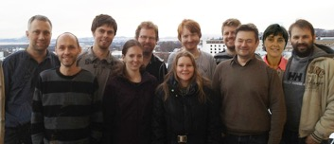
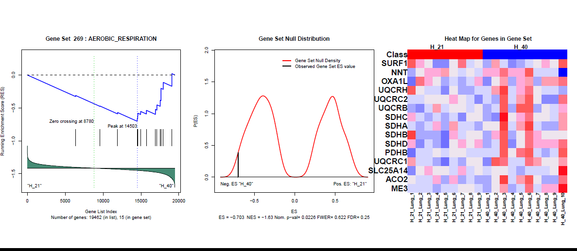
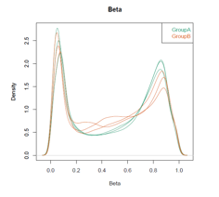
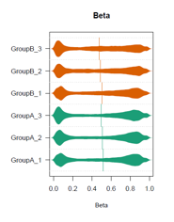
Data analysis
The Bioinformatics Core Facility in Oslo

Slide 24
Conference presentations and publications
Revhaug C., Zasada M., Rognlien A.G., Madetko-Talowska A., Bik-Multanowski M., Kwinta P., Pietrzyk J.J., Saugstad O.D. A Bronchopulmonary Dysplasia Model in Newborn Mice. Neonatology 2015; 107: 379-380 (IF=2,649) 30th International Workshop on Surfactant Replacement, Stockholm, June 5-6, 2015
Madetko-Talowska, A.; Grabowska, A.; Książek, T.; Szewczyk, K.; Suski, M.; Bik-Multanowski, M.; Kwinta, P.; Pietrzyk, J.J. Influence of hIgh oxygen concentrations on the proteome of blood MNC in premature babies - methodology J. Perinat. Med. 2015; 43: 637; DOI 10.1515/jpm-2015-2003 (IF=1,358) 12th World Congress of Perinatal Medicine November 3 - 6, 2015, Madrid
Revhaug C., Zasada M., Rognlien A.G., Baumbusch L., Madetko-Talowska A., Bik-Multanowski M., Kwinta P., Pietrzyk J.J., Saugstad O.D. A Murine Model of Bronchopulmonary Dysplasia – A Preliminary Results from Whole-genome mRNA Expression Study in Blood In: Selected Abstracts of the 1st Congress of joint European Neonatal Societies (jENS 2015); Budapest (Hungary); September 16-20, 2015; Session “Pulmonology”. J Pediatr Neonat Individual Med. 2015; 4: e040213. doi: 10.7363/040213.
Revhaug C., Whole-Genome Changes in a Mouse Model of Bronchopulmonary Dysplasia Stunting Lung Growth- Highlighting elements of aberrant alveolar development. The seventh scientific symposium of the University of Giessen and Marburg Lung Center School, Schloß Waldeck, Hessen, Germany 7th – 8th December, 2015
Revhaug C., Zasada M., Rognlien A.G., Baumbusch L., Madetko-Talowska A., Bik-Multanowski M., Kwinta P., Pietrzyk J.J., Saugstad O.D. Exploring the Blood and Lung Transcriptome of Mice with Bronchopulmonary Dysplasia Neonatology 2016; 109: 388. 31st International Workshop on Surfactant Replacement Naples, Italy June 3-4, 2016

Slide 25
Press conferences

